Slide 1
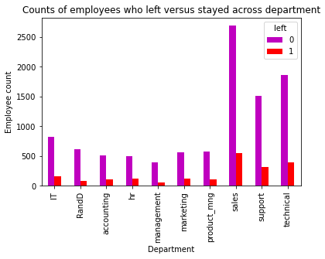
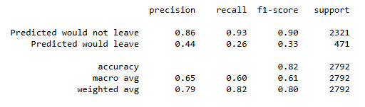
Sailfort Motors
Employee Retention Project: Executive Summary
Sailport Motors is seeking to improve its employee retention and answer the following question:
What is likely to make a Sailport Motors employee leave the company?
Bar graph showcasing the counts of employees who left versus stayed across all departments at Sailfort Motors.
Since the variable that is being predicted is categorical, the data team has the choice to either build a logistic regression or a tree-based machine learning model.
This report highlights how the logistic regression model achieved a precision of 79%, recall of 82%, f1-score of 80% (all weighted averages), and accuracy of 82%.
This model will be helpful the prediction of whether an employee will leave and identify which factors most contributed to their departure.
HR can utilize the insights gathered from the model in order to guide in the decision making to help improve employee retention rates.
It is recommended that Sailfort Motors pursues the following plans of action to improve employee retention:
Place a cap on the number of projects that employees can work on.
Consider promoting employees who have been with the company for a minimum of 4 years, or to conduct further investigation focused on why such a significant level of dissatisfaction is present amongst 4-year employees.
Either reward employees for working longer hours, or do not make long hours mandatory.
All employees must be familiar with Sailport Motors rules around hours logged in. The expectations around work hours and time off must be made explicitly clear.
Sailport Motors should conduct both company-wide and individual team discussions in an effort to better understand and address the company work culture, across the board and in specific workplace situations..
A proportionate scale for rewarding employees should be implemented. For instance, high evaluation scores should not be exclusive to only employees who work 200+ hours per month.

